Slide 1
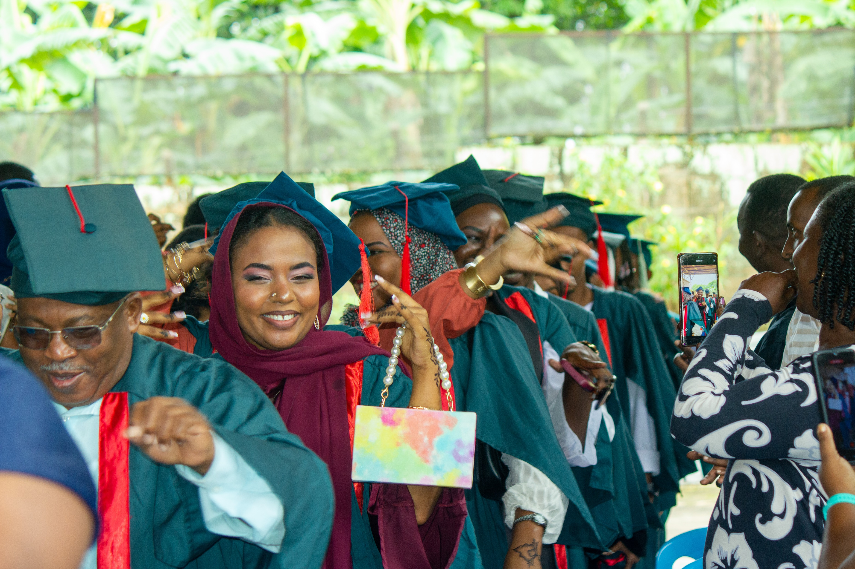
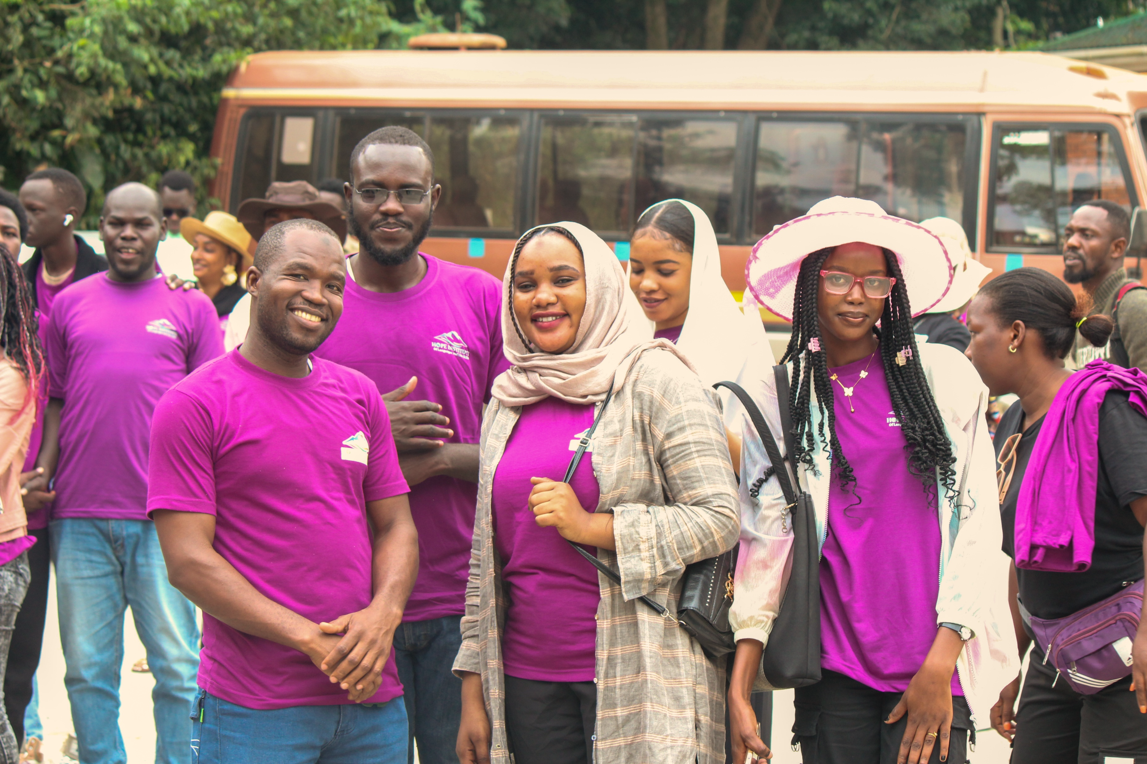




ABOUT US
OUR VISION
Hope Institute of Languages and Life Skills is a vocational institute based in Kansanga. We specialize in teaching English as a second language alongside a variety of practical trade skills designed to empower our students for success.
To create a safe and supportive learning environment with quality facilities that deliver a world-class educational experience.
OUR MISSION
To provide learners with hands-on skills, practical knowledge, and creativity to thrive in today’s job market.
Get In Touch:
For more information regarding intakes, interviews and our general services, fell free to reach out to us:
Mitala Road, Kansanga, Kampala, Uganda
Join us for professional vocational training and language mastery.
0767 935 988 | 0701 900 922
customerservice.hills@gmail.com
ADMISSIONS OPEN

Slide 2
Why Choose Us?
Fees Structure
Practical Skills First: We focus on "Gifted Hands," ensuring every student masters their craft through 100% hands-on training.
Flexible Learning: Whether you prefer online sessions or physical classes in Kampala, we accommodate your busy schedule.
Entrepreneurship Focus: Our short courses in detergent production are designed to help you start your own business in just 3 to 5 days.
Professional Certification: Earn a certificate upon completion to validate your skills for the job market or further studies.

